Slide 1
Understanding Effectiveness of Privacy Attacks on ML models
Group 4 with Oracle Labs

Slide 2

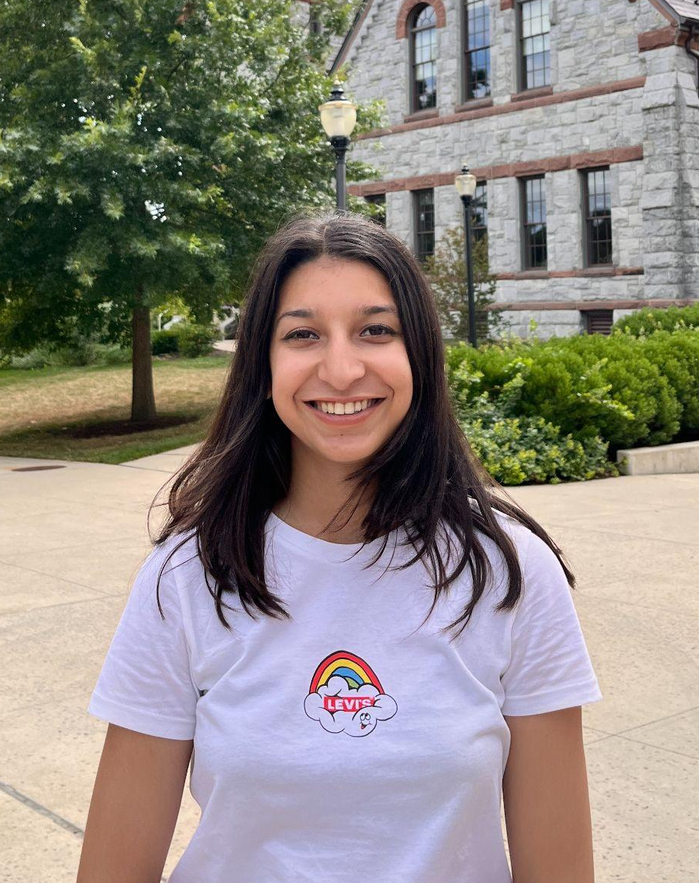
Team
PhD Mentor:
Kalpesh Krishna
Industry Mentors
{Oracle Labs}:
Pallika Kanani
Virendra Marathe
Nandyala Siddharta Kantu
Ananya Kamboj
Atharva Nijasure

Slide 3
Introduction
Increased use of ML models in processing sensitive data
ML Models vulnerable privacy attacks like Membership Inference Attack (MIA)
MIA: Determining whether a specific data point was used to train a model.
MIA: Compromise of privacy of individuals whose data being used to train the models.
MIA: Help us quantify risk of such data leakage, often a function of model or dataset that it is trained on.

Slide 4
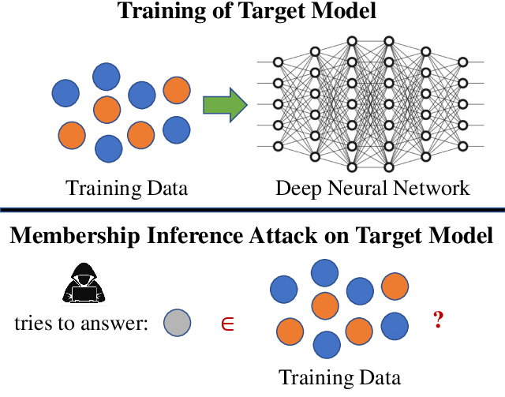
source: https://www.researchgate.net/figure/The-membership-inference-attack-MIA_fig1_342464437
Notes:
https://www.researchgate.net/figure/The-membership-inference-attack-MIA_fig1_342464437

Slide 5
Research Task Description
What factors make ML models vulnerable to membership inference attacks?
Is it the properties of data?
Is it the properties of ML models?
Is it both?
?
data
?
model
??
both
Notes:
Properties of data: type of data, number of classes, dimensionality of the data, distribution of data

Slide 6
Proposed Approach
Vary parameters
Train a model
Evaluate the privacy of the model using MIA
Analyze the correlation between data & model properties vs. vulnerability
build a tool to automate this process

Slide 7
Proposed Approach
train ML models using standard benchmark datasets under varying parameters
evaluate the vulnerability of different machine learning (ML) models to membership inference attacks on different datasets.
identify the impact of various model architectures and hyperparameters on the vulnerability of ML models
compare the performance of different ML models across various datasets to determine the relative importance of algorithm & data properties.
use a variety of datasets: tabular, text, image
build a tool to run end-to-end privacy attacks and evaluate membership attack privacy.

Slide 8
Adversarial Knowledge
What knowledge does the adversary have?
Based on the adversary’s knowledge, different attacks can be tailored.
Types of knowledge:
Access to ML APIs
Model Parameters
Training Settings
Prediction Results
Training Data Distribution
TYPES OF ATTACKS
Black Box Attack
White Box Attack
Notes:
Adversary has no knowledge of the model parameters, architecture, or training data are called black-box attacks. Most black-box papers assume the existence of a prediction vector.
white-box attacks are those where the adversary has either complete access to the target model parameters or their loss gradients during training.

Slide 9
Related Work
Membership Inference Attacks: datapoint in training data?
Reconstruction Attacks: Recreate training samples.
Property Inference Attacks: For eg: get the ratio of men & women in a dataset.
Model Extraction Attacks: Get the model.
Notes:
Model extr - bb attack

Slide 10
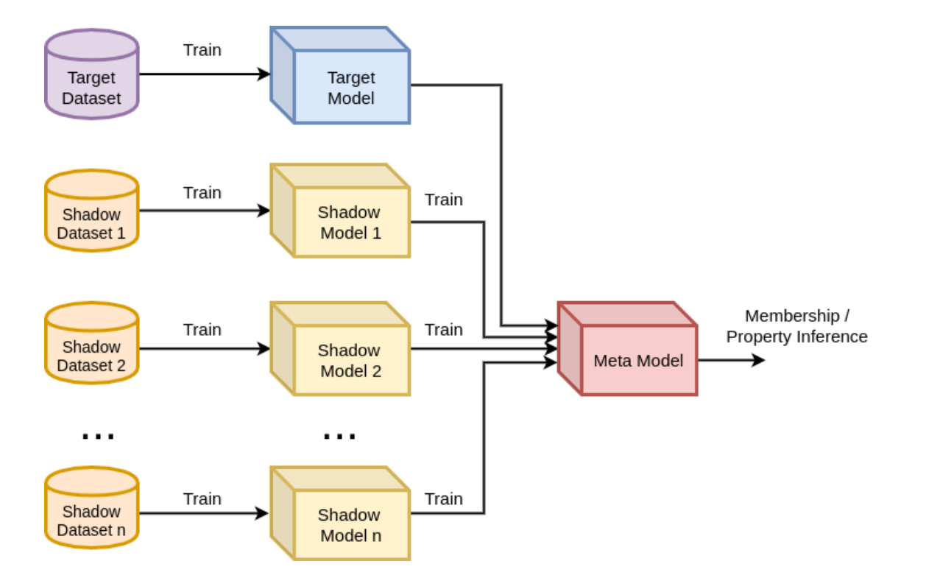
Related Work
TensorFlow privacy uses this attack.
Intuition: Similar models trained on relatively similar data records using the same service behave in a similar way.
Image source: Shokri, Stronati (2017): Membership Inference Attacks Against Machine Learning Models

Slide 11


[0,0,0,0,1,0,0,0,0]
[0.04,0.06,0,0,0.9,0,0,0,0]
[0.1,0.2,0.05,0,0.75,0,0,0,0]

Slide 12
Causes of Privacy leaks
Overfitting
Model architecture - complexity
Model Type
Dataset Structure
Number of Classes
Even making the model better against adversarial attacks!!!

Slide 13
Limitations of Existing Work
a lack of analysis of the impact of different model architectures and hyperparameters on vulnerability.
limited exploration of the effectiveness of different techniques for enhancing model privacy.

Slide 14
Likely Challenges & Mitigation
Quick alteration in the privacy measuring libraries. Some of the commits are unstable and do not work.
No clear correlation between model properties and information leakage to come to conclusion
Different datasets, Different models, Different properties
Loading different types of datasets with a single software tool might encounter challenges.

Slide 15
Experiments: Datasets & Software
Datasets: planning to use benchmark datasets, publicly available
Tabular: Adult Income, Titanic, Wine Quality etc.
Text: 20ng, IMDb, movielens
Image: cifar-10,cifar-100, MNIST
Software Tools: open source privacy measurement tools
ML Privacy Meter: provides privacy levels of a model and data
TensorFlow Privacy: training models using differential privacy
We aim to build a wrapper around ml-privacy-meter and tensorflow-privacy to streamline the process of creating and testing membership inference attacks on various datasets.
Notes:
ML-Privacy-Meter provides model privacy levels for given models and data.
end-to-end testing tool is required to test new attacks or model’s parameter co-relation with information leakages.
Streamline and simplify the process of creating and testing membership inference attacks on various datasets
Functions: Pre-process data, train models, perform attacks, record results

Slide 16
Weekly Timeline
Week | Task
Week 1 | Create a tool to enroll new datasets, run end to end privacy attacks
Week 2 | Create a tool to enroll new datasets, run end to end privacy attacks
Week 3 | Loading datasets, preprocessing, ml models implementations
Week 4 | Run attacks on all datasets
Week 5 | Verify results and iterations
Week 6 | Identify trends and prepare a summary

Slide 17
Questions and Feedback

Slide 18
Thank you.

